Slide 1
Euclid space telescope
Espansione dell’Universo

Slide 2
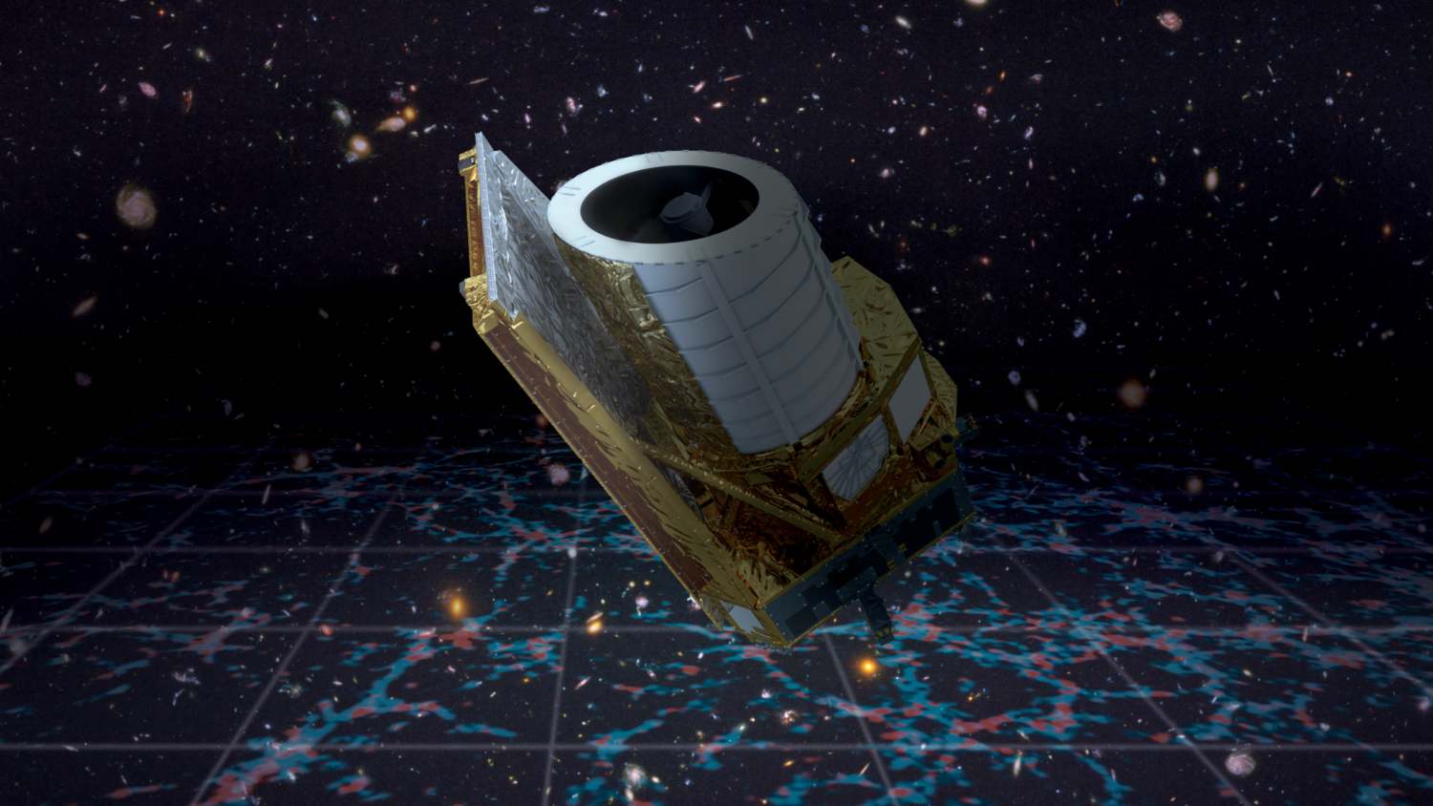
Il telescopio spaziale Euclid
Notes:
Image of Euclid space telescope Wiki commonshttps://www.google.com/url?sa=i&url=https%3A%2F%2Fcommons.wikimedia.org%2Fwiki%2FFile%3AEuclid_ESA376594.jpg&psig=AOvVaw3nTTLs8F1ig7m2F_mIdyh1&ust=1678643896228000&source=images&cd=vfe&ved=0CA0QjhxqFwoTCKDGu4m61P0CFQAAAAAdAAAAABA8

Slide 3
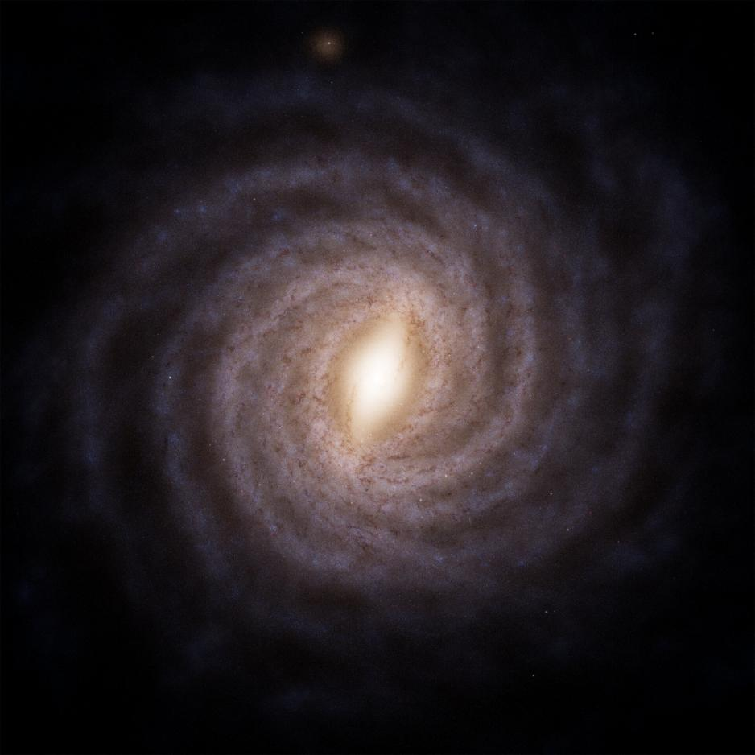
La Via Lattea: la nostra galassia
Notes:
Image: Wikimedia commons

Slide 4
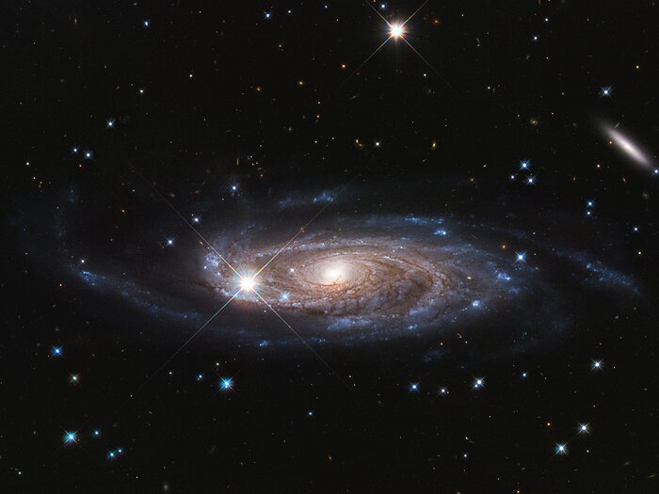
Esempio di grande galassia spirale
Notes:
Credit:NASA, ESA, and B. Holwerda (University of Louisville).

Slide 5
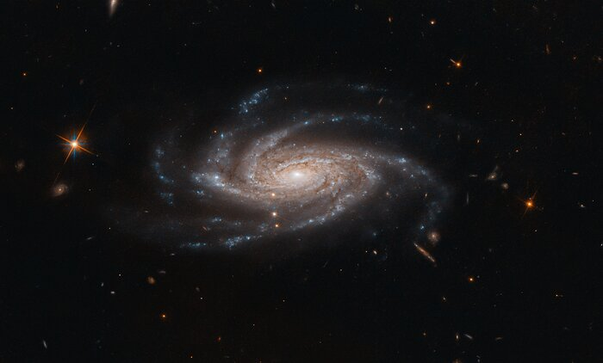
Una galassia spirale con i suoi bracci
Notes:
Credit:ESA/Hubble & NASA, A. Bellini

Slide 6
Un’animazione per mostrare l’espansione dell’Universo
https://esahubble.org/videos/hubblecast79d/
Notes:
Credit:Martin Kornmesser, Luis Calcada, NASA, ESA/Hubble
ESA/Hubble images, videos and web texts are released under the Creative Commons Attribution 4.0 International license and may on a non-exclusive basis be reproduced without fee provided they are clearly and visibly credited. Detailed conditions are below.

